Slide 1
Integrated Data Pipeline for Proactive Loan Risk Management
Turning High-Volume Loan Data (2007-2011) into Actionable Policy

Slide 2
Problem Statement
Untested Risk Indicators: Management was relying on intuition, not data, to identify high-risk loans.
Inaccessible Data: Data was fragmented across multiple files, making scalable, real-time reporting impossible.
Goal Statement: The goal is to transform fragmented data into statistically validated, interactive business intelligence.

Slide 3
The End-to-End Solution Pipeline
Our Integrated Solution: The 3-Stage Data Pipeline
Stage 1 (SQL)Data Engineering & Consolidation: Clean, join, and pre-calculate core KPIs from 39K+ records. The foundation of the project.
Stage 2 (Excel)Statistical Validation & Forecasting: Use advanced analysis (ANOVA, Time Series) to prove which factors actually matter.
Stage 3 (BI Tool)Interactive Reporting: Deliver self-service, visual dashboards for executive decision-making.

Slide 4
SQL - The Foundation
SQL for Data Consolidation and KPI Generation
Key Action 1:
LEFT JOIN: Merged two complex data files (FINANCE_MAIN & FINANCE_DETAILS) using the unique ID.
Key Action 2:
Pre-Calculated Metrics: Aggregated Year-wise Loan Amount and Revolving Balance by Grade to streamline BI performance.

Slide 5
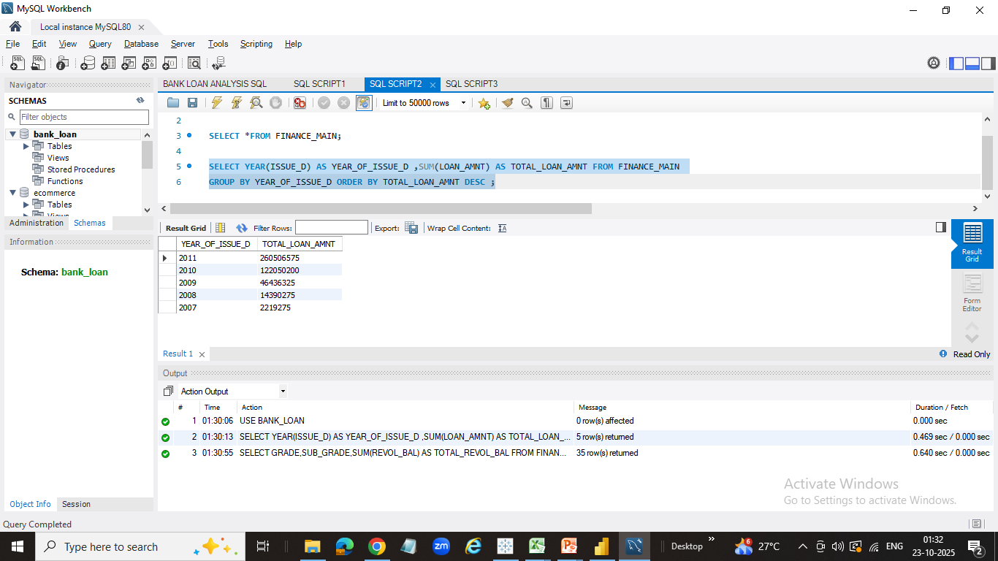
KPI OUTPUT- SQL
1. Year wise Loan Amount stats

Slide 6
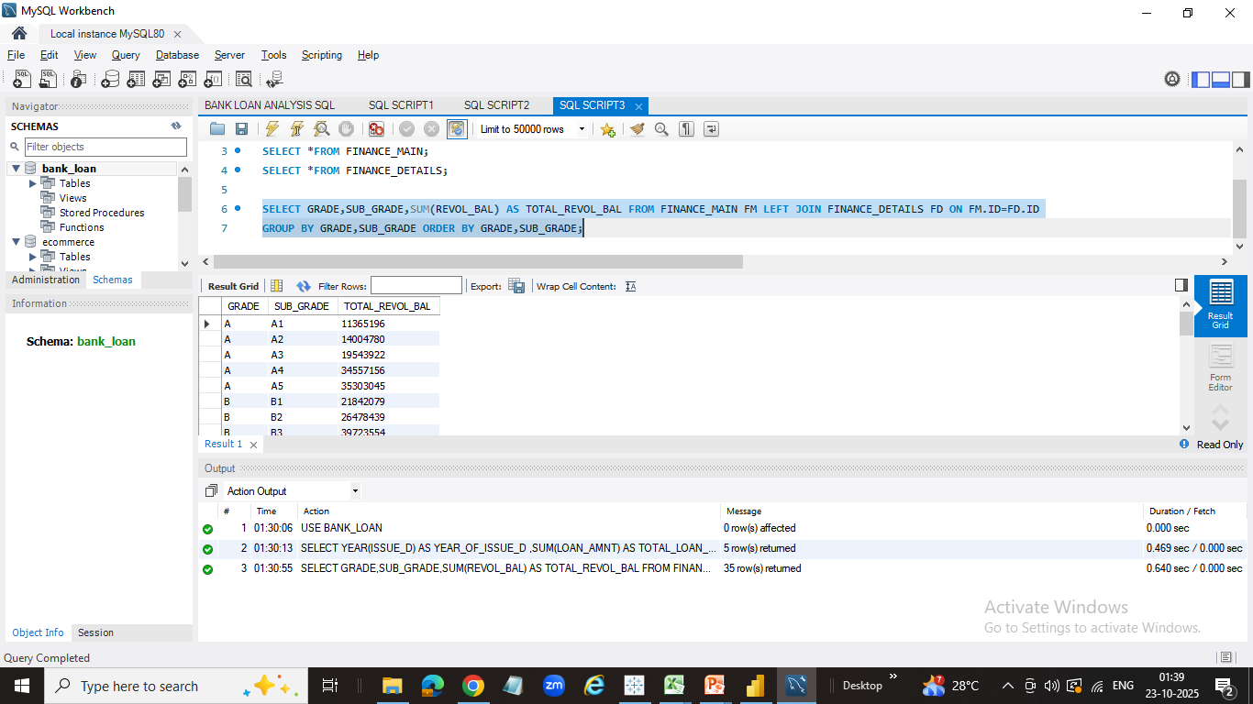
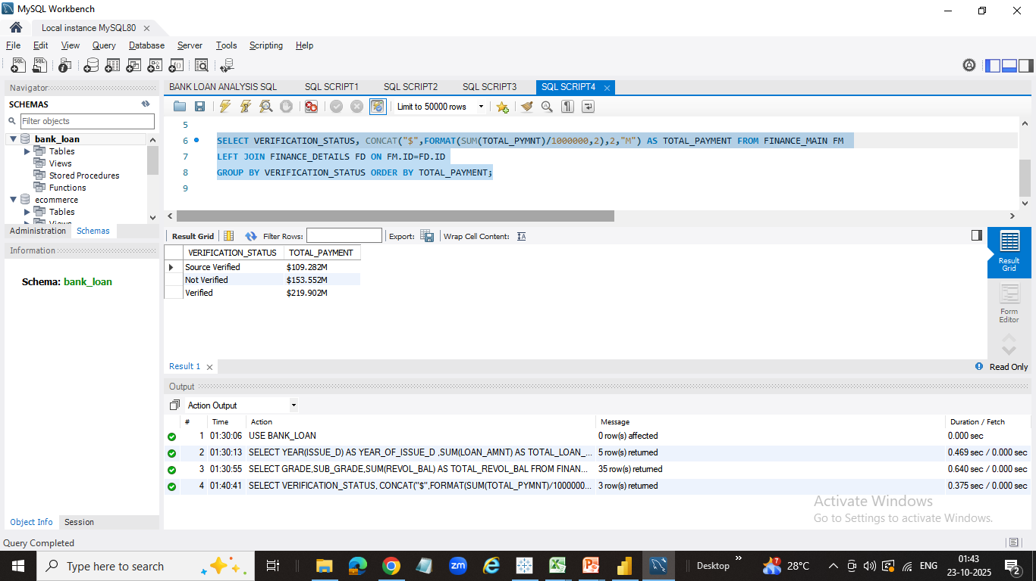
Grade wise Sub Grade wise Revol-Bal
Total Payment of verified status vs non verified status

Slide 7
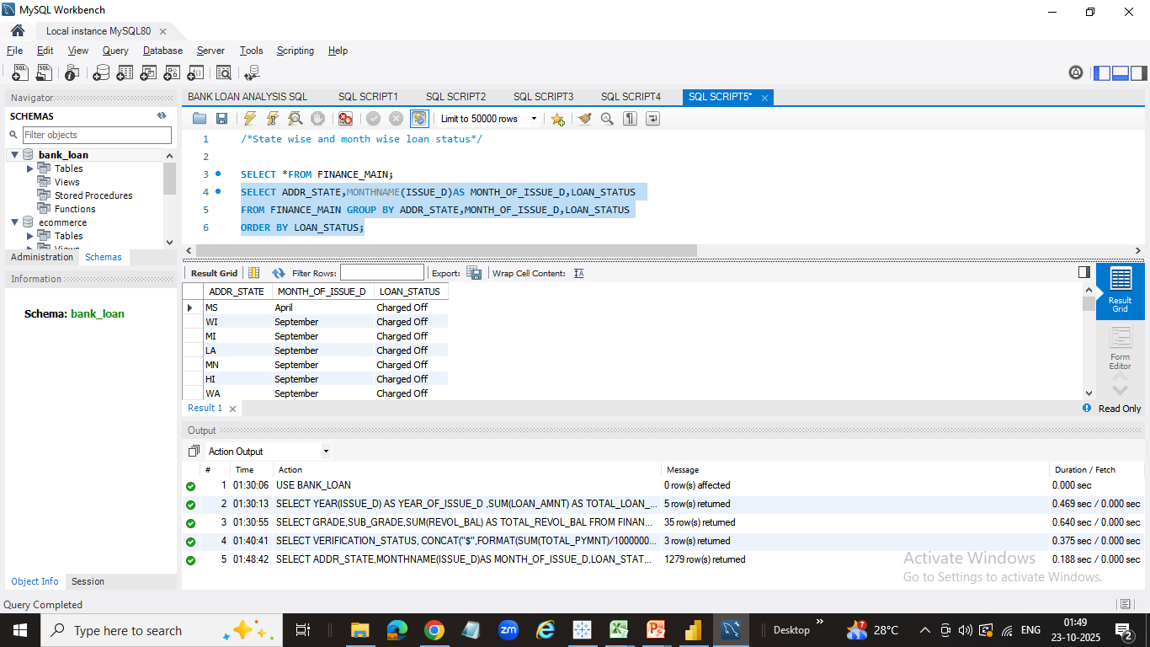
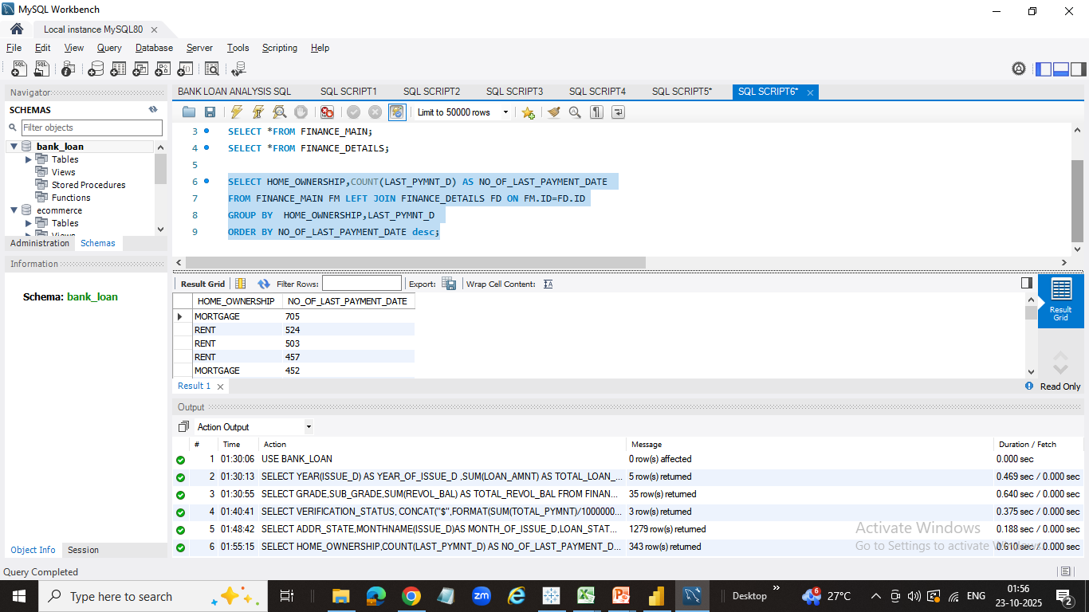
State wise Month wise Loan status
Home ownership vs last payment date status

Slide 8
PYTHON- DATA CLEANING AND VISUALS
Data cleaning:
The data has been cleaned by removing errors
Data Extraction:
The data extraction is done by converting numeric data, date time data etc.
KPI Metrics:
Creating visuals using Sea-Born and Matplotlib by generating the codes for data driven insights

Slide 9
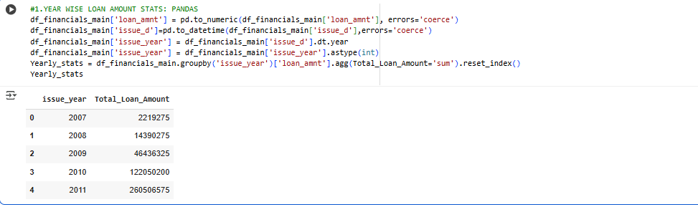
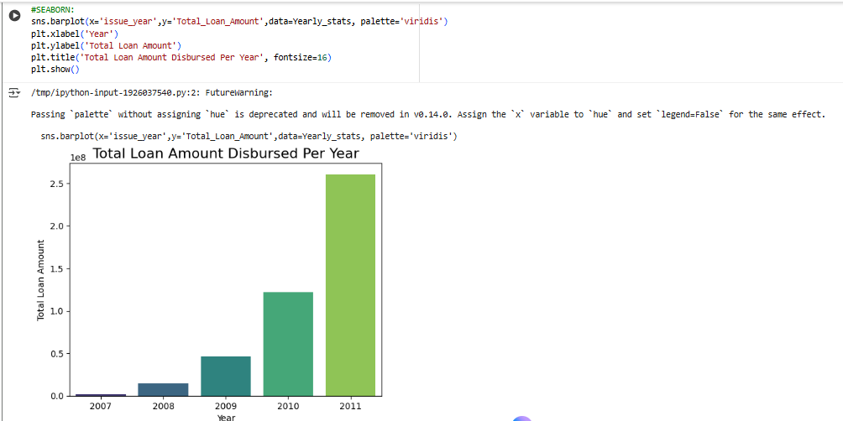
1.Year wise loan amount stats

Slide 10
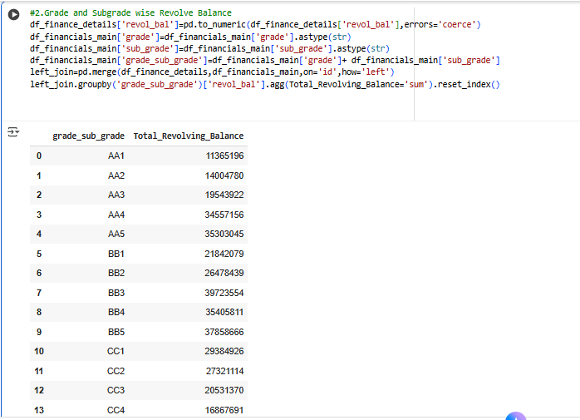
Grade wise subgrade wise Revol bal

Slide 11
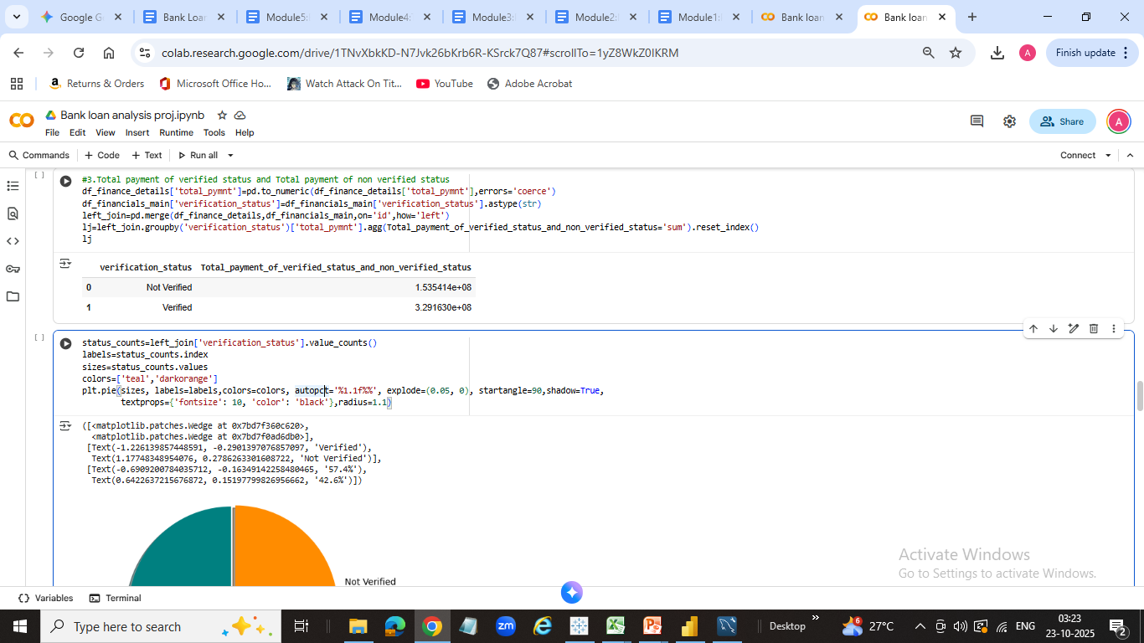
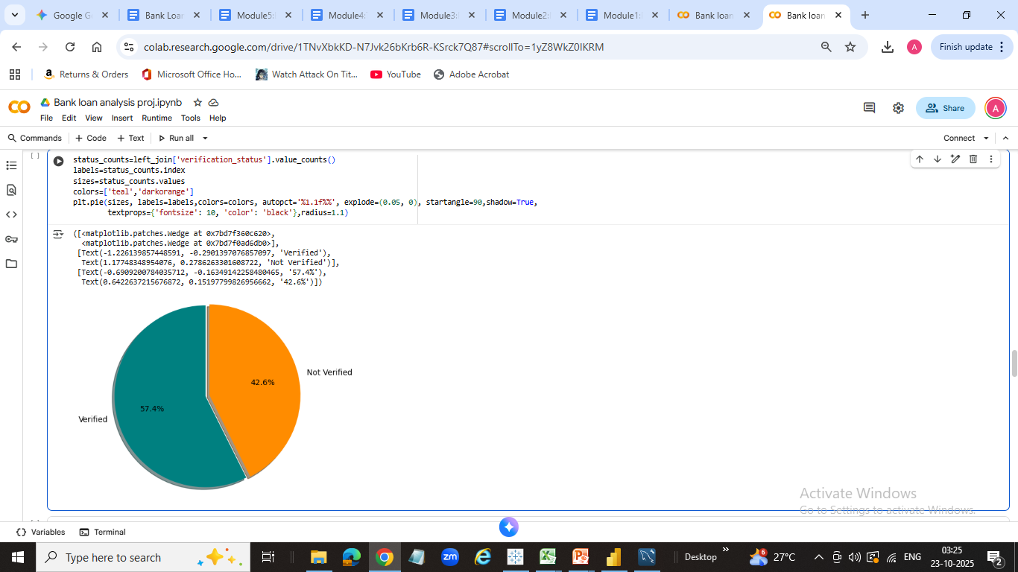
Total payment for verified vs not verified status

Slide 12
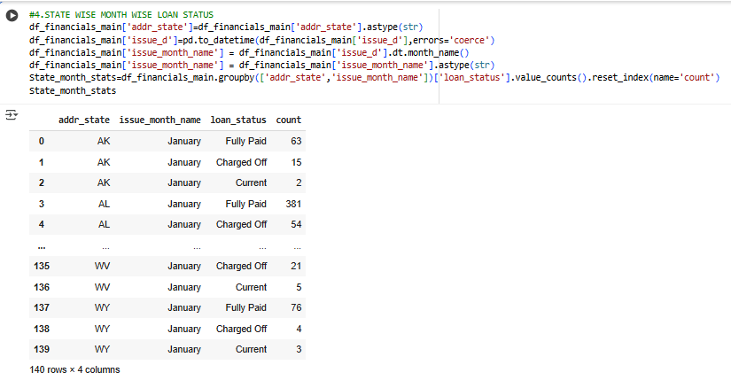
State wise month wise loan status

Slide 13
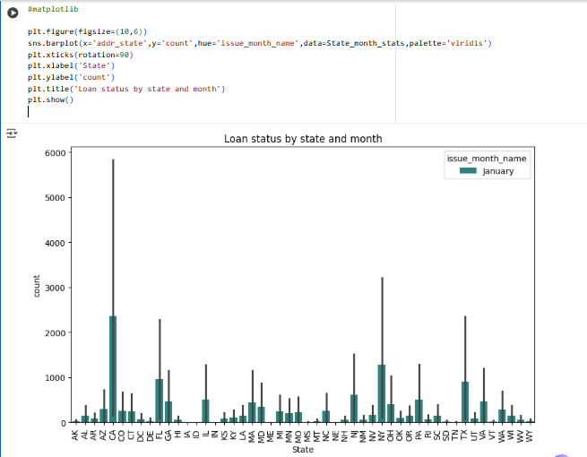
Matplotlib- State/month wise Loan status

Slide 14
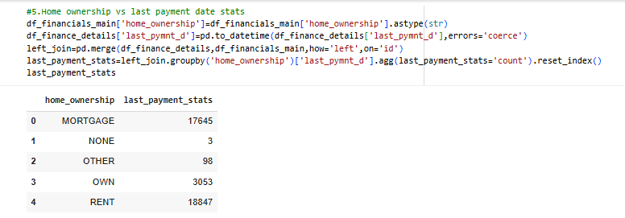
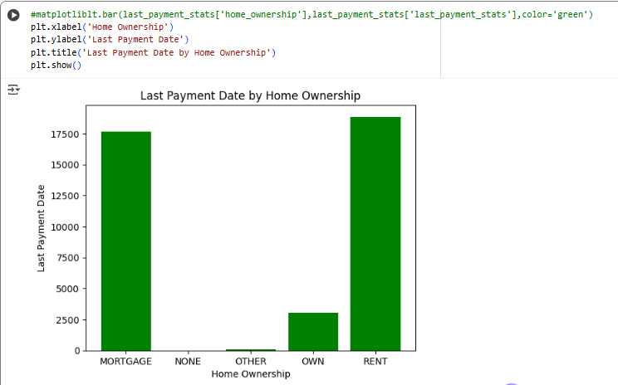
Home ownership vs Last payment date stats

Slide 15
Excel - The Proof
Stage 2: Excel Proves 'Verification Status' is a Critical Risk Factor.
Method 1: ANOVA Test
Result: F-Statistic (5195.88) >> F-Critical (3.84). P-value $\approx. 0$.
Takeaway:
Statistically Proven: Income Verification Status has a significant, proven impact on the Total Payment received.
Method 2: Time Series
Finding: Confirmed Exponential Growth (Loan Amounts from $2.2M to $260.5M).

Slide 16
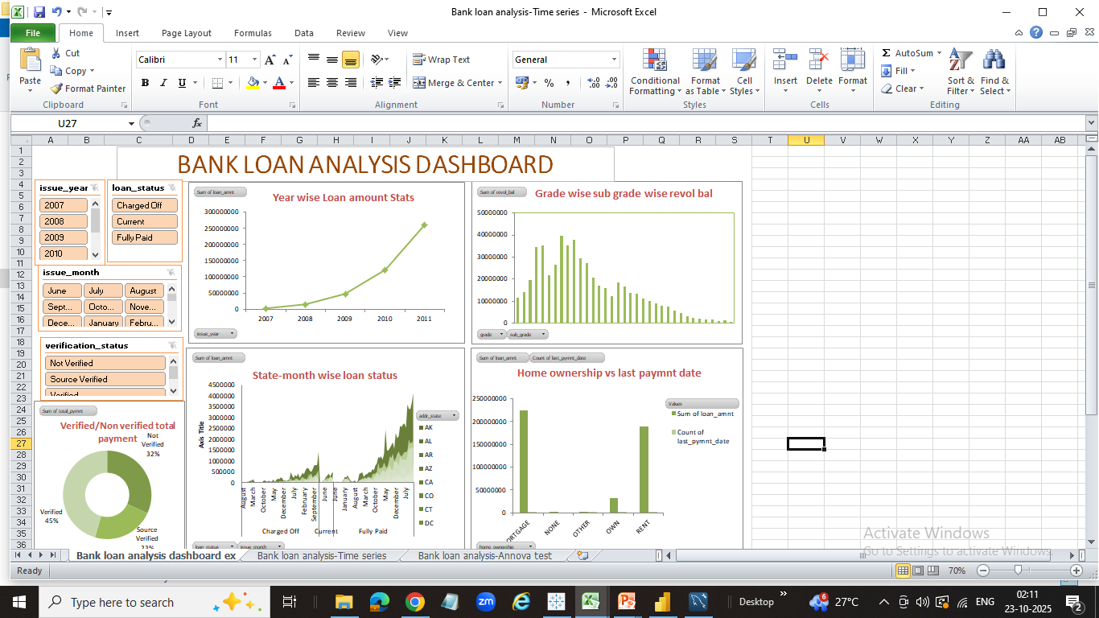
KPI OUTCOME- EXCEL

Slide 17
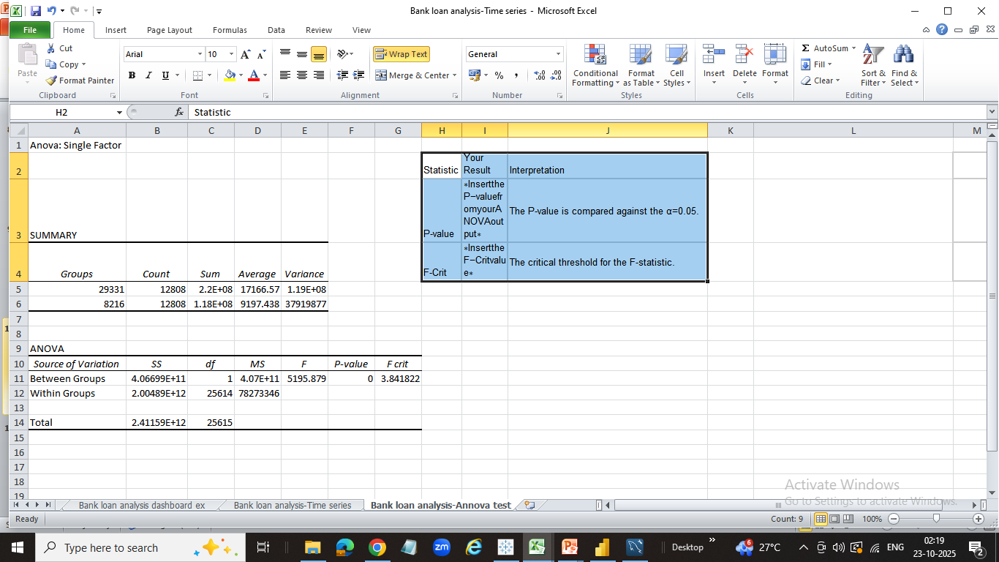
KPI OUTCOME-EXCEL/STATISTICS
ANNOVA TEST

Slide 18
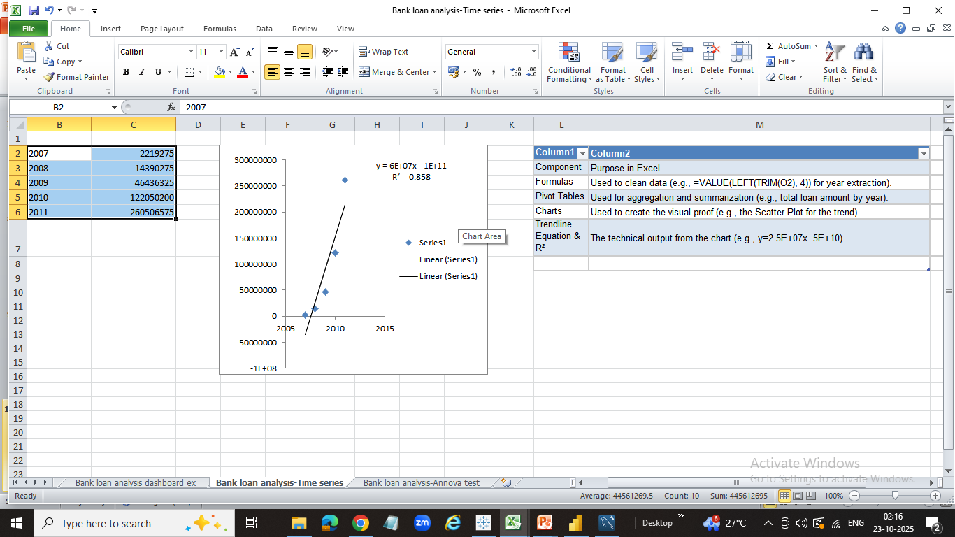
KPI OUTCOME-EXCEL/STATISTICS
TIME SERIES

Slide 19
Power BI/Tableau - The Visuals
Stage 3: Interactive Visuals for Self-Service Decisions
Visual 1:
Loan Status by State/Grade: Identified California, New York, and Texas as the highest volume markets.
Visual 2
Total Payment: Verified vs. Not Verified (Visual confirmation of the ANOVA test).
Impact
Self-Service: Executives can now drill down by Year, Grade, or Loan Status without waiting for a custom report.

Slide 20
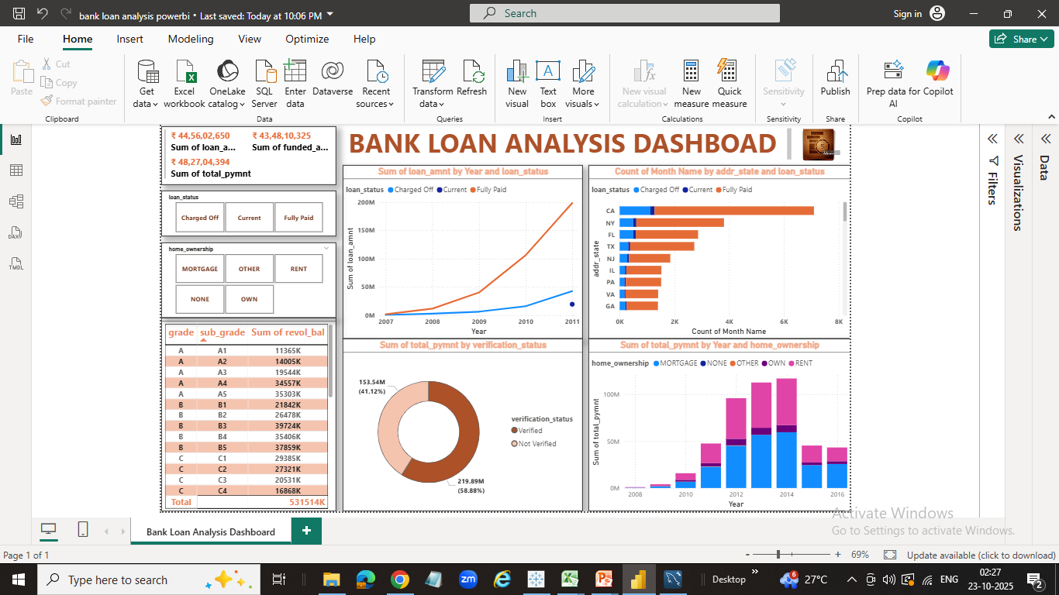
KPI OUTCOME-POWER-BI

Slide 21
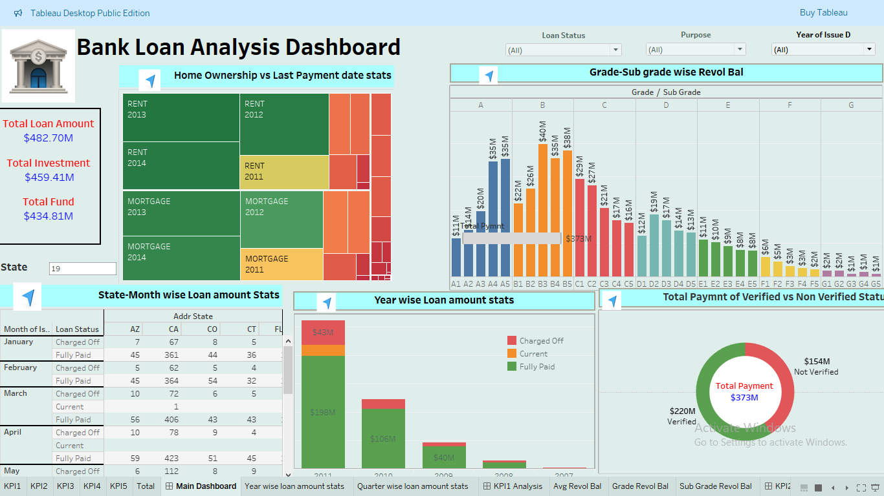
KPI OUTCOME-TABLEAU

Slide 22
Key Findings and Recommendations
Actionable Insights & Policy Recommendations
Recommendation 1:
Mandate Verification: Implement a strict policy requiring Verified Status for loans above $15,000 to maximize returns.
Recommendation 2:
Resource Scaling: Use the exponential growth forecast to proactively plan for increased capital and underwriting staff.
Action based on the Time Series analysis.
Recommendation 3:
Targeted Monitoring: Prioritize monitoring of high-risk credit grades (F, G) within high-volume states (CA, NY, TX)
Action based on the BI visuals.

Slide 23
CONCLUSION & FUTURE ANALYSIS
Future-Proofing the Portfolio
Summary
We have successfully deployed a robust data pipeline that converts raw loan data into statistically validated risk intelligence. Reinforce the value proposition.
Future Analysis
Develop a predictive machine learning model based on the verified factors.
2. Integrate the pipeline into a real-time data warehouse.

